Slide 1

QuickBite
Food Delivery Application
21/11/2024
Mangalore Institute of Technology & Engineering
Department of master of computer applications
By,
Shruthakeerthiraj(4MT23MC070)
Shwetha(4MT23MC071)

Slide 2
The online food delivery market has seen substantial growth, driven by consumer demand for convenience and variety.
Rapid growth of online food delivery market
Introduction to Quick Bite Online Food Delivery
User-centric design focusing on convenience
Ouick Bite prioritizes user experience by designing an intuitive interface that simplifies the ordering process.
Integration of modern technologies for enhanced user experience
The app incorporates cutting- edge technology to streamline food ordering and provide real- time updates.
^œn'ea 1°nç
preseutotions

Slide 3

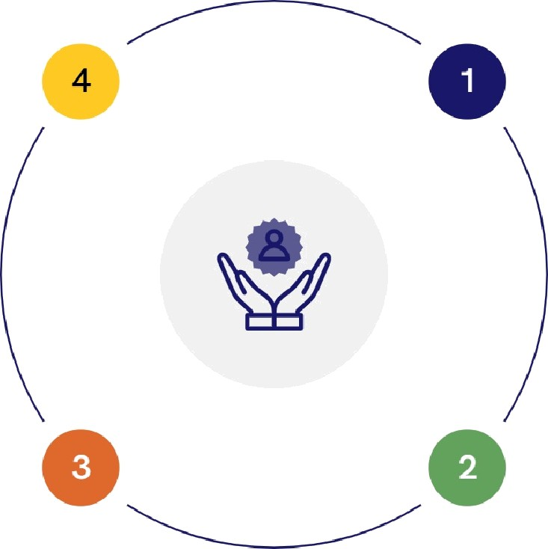
Identifying the Challenges in Food Delivery
Understanding key issues affecting user satisfaction and efficiency
Restaurant Management Difficulties
Many existing platforms do not offer robust tools for restaurant analytics, complicating management.
Delivery Delays
Poor coordination often results in late deliveries, affecting customer satisfaction.
Transparency Problems
Lack of real-time tracking leads to customer frustrationdue to uncertainty about order status.
User Experience Issues
Complicated interfaces hinder quick order placements, leading to frustration.
^œn'ea 1°nç
preseutotions

Slide 4

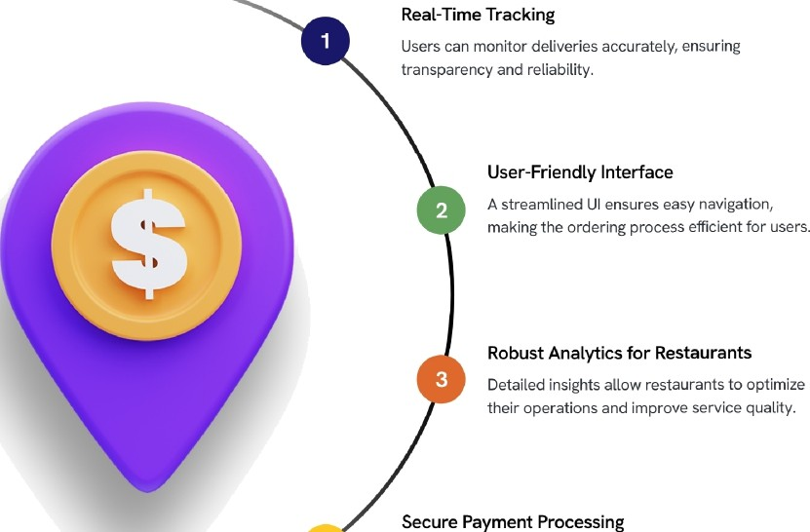

Quick Bite's Unique Selling Proposition
4
Multiple payment options enhance user trust and convenience, ensuring a safe transaction experience.

Slide 5
Architectural Overview of Quick Bite
Comprehensive Analysis of Ouick Bite Online Food Delivery
Frontend Development
.
Database Security
Secure storage of user and order data in MongoDB ensuring data integrity and security
Engaging user interface developed in React.js for enhanceduser experience
Backend Managaement
Efficient order management system utilizing Node.js and Express.js for seamless operations.

Slide 6
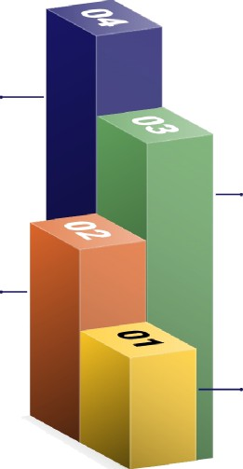
Core Features of the Quick Bite Application
User Dashboard
Browse menus, place orders, and track deliveries
seamlessly.
Admin Dashboard
Manage menus, orders, and customer interactions efficiently
Payment Integration
Supports multiple payment methods for user convenience.
Order Management
Efficient workflows for updating order statuses and handling cancellations.
^œn'ea 1°nç
preseutotions

Slide 7

User Experience Design Principles
Customization
User preferences are saved for future orders, providing a personalized experience.
Simlicity
Clear navigation and minimalistic design to make interactions intuitive.
Feedback
Immediate notifications on order status and promotions to keep users informed.
Accessibility
Responsive design ensures usability across all devices, enhancing reach.

Slide 8



Payment Security and User Trust
Encryption
AU payment data is encrypted using industry-standard protocols to prevent unauthorized access
Multi-Factor Authentication
Additional verification steps are implemented during sensitive transactions to enhance security.
Secure Payment Gateways
Integration with Stripe ensures reliable processing and protection against fraud.

Slide 9
Restaurant Management Features
Empowering Restaurants for Operational Excellence
1
2
Dynamic Menu Updates | Order Analytics | Customer Feedback Tools
Restaurants can instantly | Gain insights into sales patterns | Receive direct feedback from
modify their offerings to reflect | and identify popular dishes to | customers to enhance service
current trends and customer | optimize inventory and | quality and improve overall
preferences. | marketing strategies. | dining experience.
^œn'ea 1°nç
preseutotions

Slide 10



Role-Based Access Control
.
Implements varying access levels for users and administrators, ensuring data
protection
User Authentication and Security
Password Hashing
Employs Bcrypt to encrypt user passwords, enhancing security against breaches.
3WT Authentication
Utilizes 3SON Web Tokens to manage sessions securely, ensuring data integrity

Slide 11
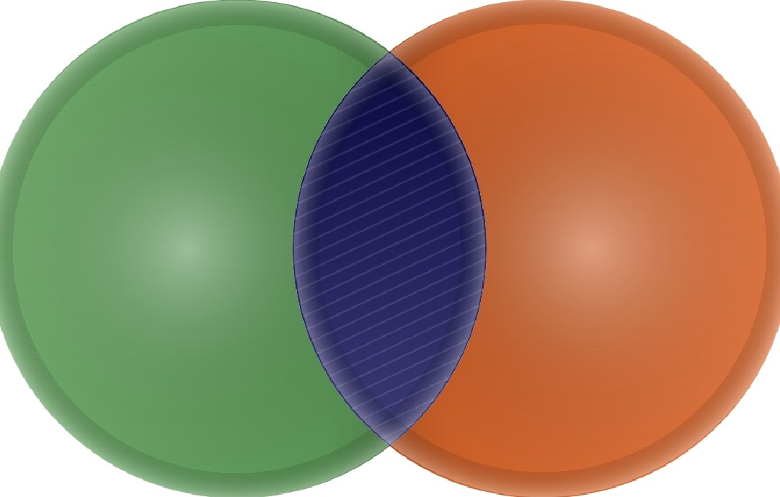
Testing Methodologies for Quality Assurance
Unit Testing
Isolating andindividual components to ensure their correctness.
Integration Testing
User Acceptance Testing
Checking interactions between backend APls and frontend functionalities for
seamless operation.
Gathering feedback from real users to identify areas for improvement and ensure user satisfaction.
^œn'ea 1°nç
preseutotions

Slide 12
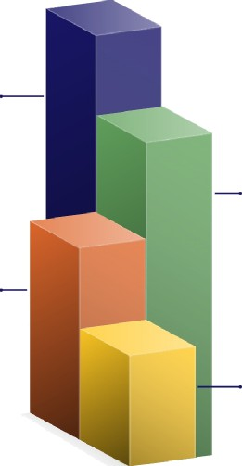
Future Enhancements for Quick Bite
Al-Powered Recommendations
Utilizing user data to provide personalized meal suggestions,
enhancing user satisfaction.
Chatbot Integration
Offering 24/7 customer support through chatbots, ensuring
instant assistance for users.
Enhanced Analytics
Deploying advanced analytics tools for restaurants to better understand customer preferences and behaviors.
Loyalty Programs
Introducing incentives for frequent users to boost retention and encourage repeat orders.
^œn'ea 1°nç
preseutotions

Slide 13
Conclusion and Key Takeaways
User-friendly experience
The application ensures ease of use for customers, enhancing satisfaction and engagement.
Efficient restaurant management
Quick Bite streamlines operations for restaurants, leading to better service and order fulfillment.
Robust security measures
The platform implements advanced security protocols to
protect user data and transactions.
Continuous improvement
User feedback is actively utilized to enhance features and overall service quality.
”
^œn'ea 1°nç
preseutotions

Slide 14
THANK YOU

